Slide 1

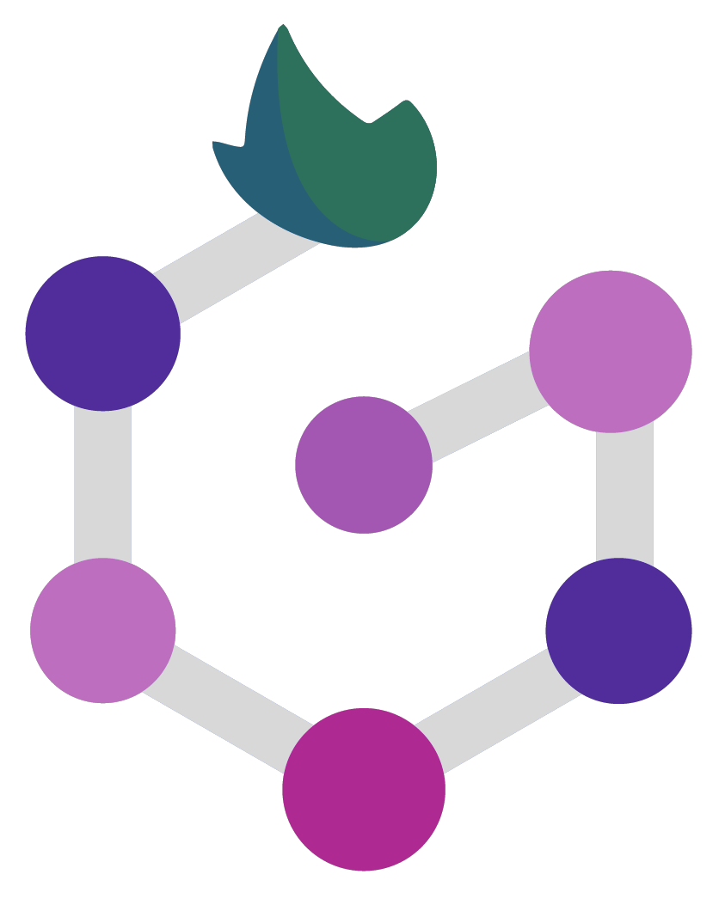

Nextflow
Santiago Radío

Slide 2
Nextflow principles: FAIR+EST
FAIR+EST is an extension of the FAIR principles for workflows

Slide 3
Nextflow principles: FAIR+EST
FAIR+EST is an extension of the FAIR principles for workflows
Findable: easy to locate and identify using unique identifiers and clear naming conventions
Accessible: easily accessible, regardless of technical background or location
Interoperable: designed in a way that promotes interoperability with other tools, software, or datasets
Reusable: designed in a way that promotes reuse by others

Slide 4
Nextflow principles: FAIR+EST
FAIR+EST is an extension of the FAIR principles for workflows
Findable: easy to locate and identify using unique identifiers and clear naming conventions
Accessible: easily accessible, regardless of technical background or location
Interoperable: designed in a way that promotes interoperability with other tools, software, or datasets
Reusable: designed in a way that promotes reuse by others
Equitable: designed in a way that promotes equity, ensuring that all users have access to the same resources and tools
Scalable: designed in a way that is scalable to handle larger or more complex datasets
Testable: designed in a way that is testable to ensure accuracy and reliability

Slide 5
Nextflow Workflow System: Key Features

Slide 6
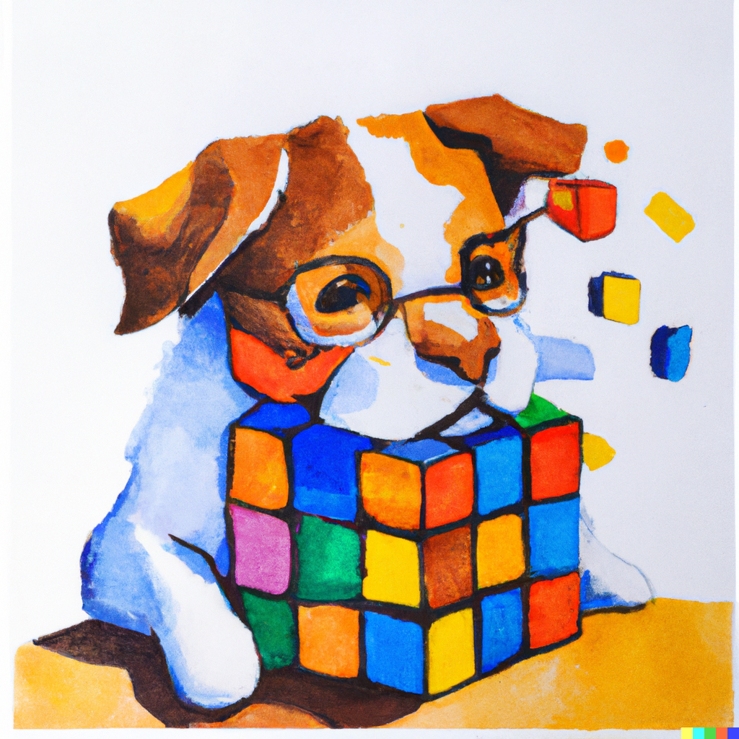
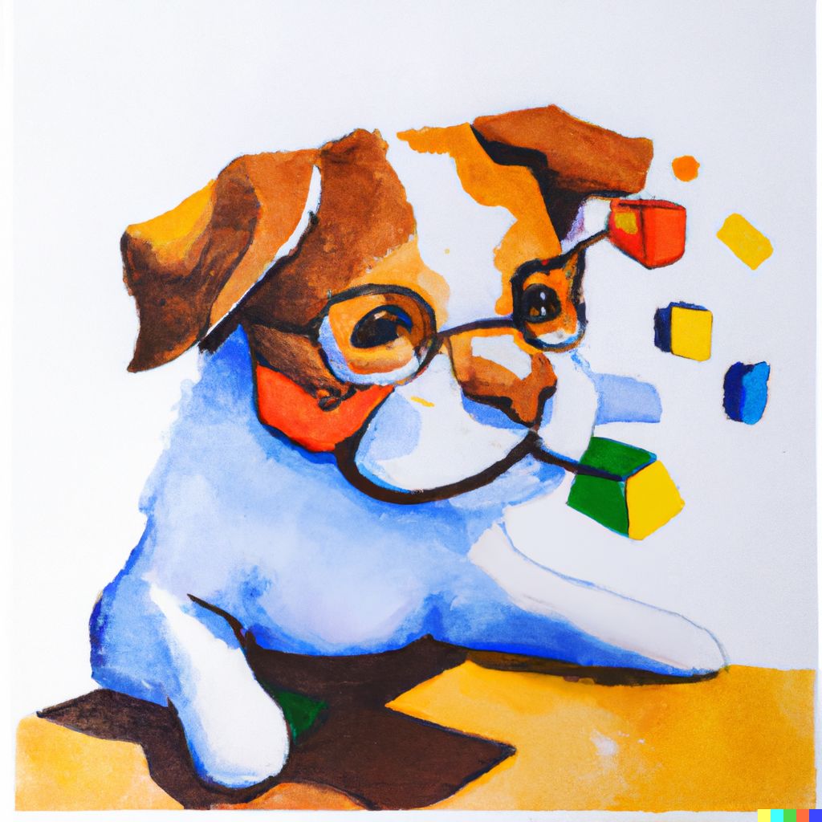
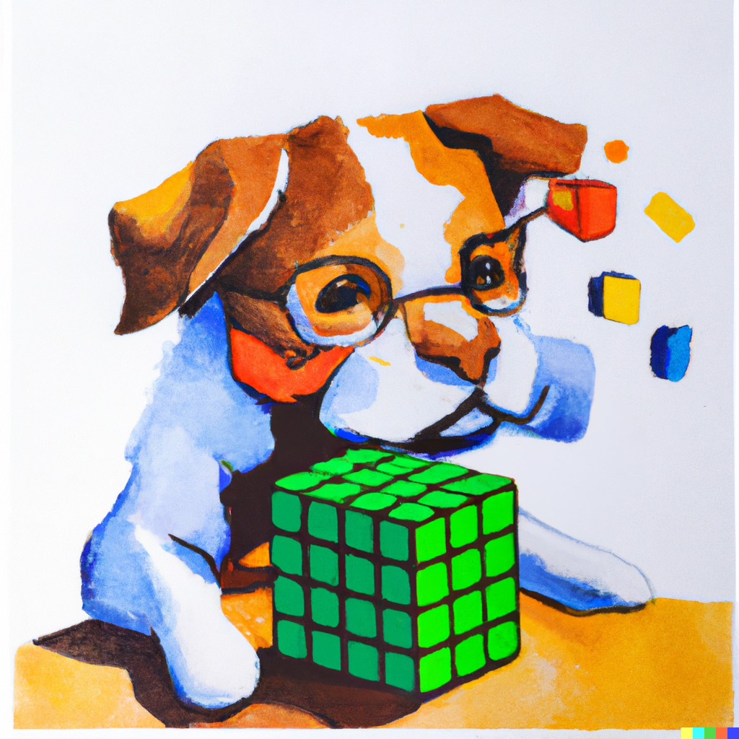

Fast and Easy Prototyping
Nextflow provides a custom DSL for easy workflow design
Users can create/use complex workflows with minimal coding effort

Slide 7

Parallel Execution
Nextflow allows tasks to be executed in parallel, speeding up workflows

Slide 8


Reproducibility and Consistency
Nextflow ensures that tasks produce the same output every time they are executed with the same input
This helps ensure reproducibility and consistency of results
I need to use the code written by ex workmate for my analysis. I will first try to reproduce his results:

Slide 9


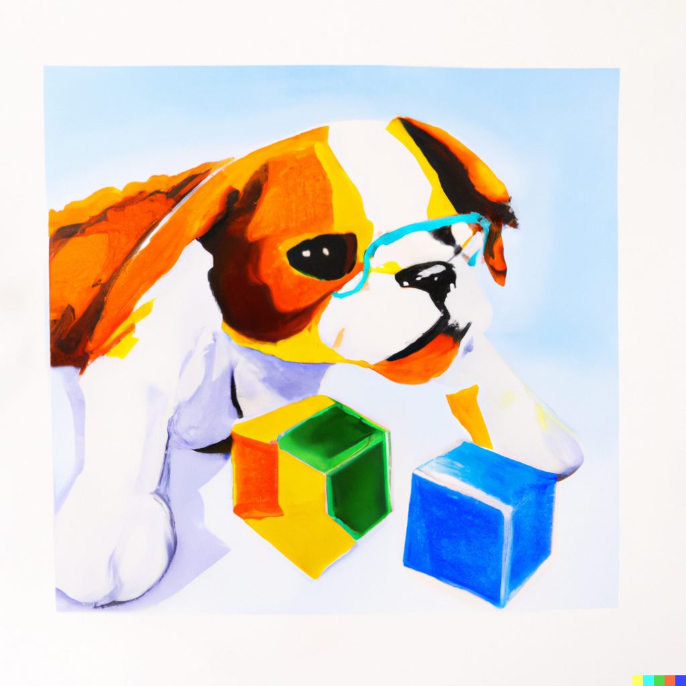


Reproducibility and Consistency
Nextflow ensures that tasks produce the same output every time they are executed with the same input
This helps ensure reproducibility and consistency of results
I need to use the code written by ex workmate for my analysis. I will first try to reproduce his results:

Slide 10

Reproducibility and Consistency
Nextflow ensures that tasks produce the same output every time they are executed with the same input
This helps ensure reproducibility and consistency of results
I need to use the code written by ex workmate for my analysis. I will first try to reproduce his results:
Did I forget to sacrifice a goat to the computational gods?
Did I forget to include the "magic" command in my script?
Did my computer catch a virus from all those genomic sequences?
Did my code fall into a black hole?
Did my data get lost in translation?

Slide 11



Portability
Nextflow can be deployed on various computing environments
This includes local computers, clusters, and cloud infrastructure

Slide 12
Benefits of Workflow System
Easy workflow design saves time and resources
Parallel execution improves workflow efficiency
Reproducibility ensures reliable results
Portability allows workflows to be run on different systems with ease
Nextflow is a flexible and scalable workflow management system suitable for a wide range of scientific applications.

Slide 13
DSL2: The Domain-Specific Language of Nextflow
The Domain-Specific Language version 2 (DSL2) is a programming language (syntax extension) used to define workflows in Nextflow.
Is used to define channels for input and output data, specify dependencies between processing steps, and define resources for running the workflow in a easy way
DSL2 in Nextflow uses the FIFO (First In First Out) data flow paradigm to manage the flow of data between processing steps, ensuring that data is processed in the correct order according to the dependencies specified in the workflow definition.

Slide 14
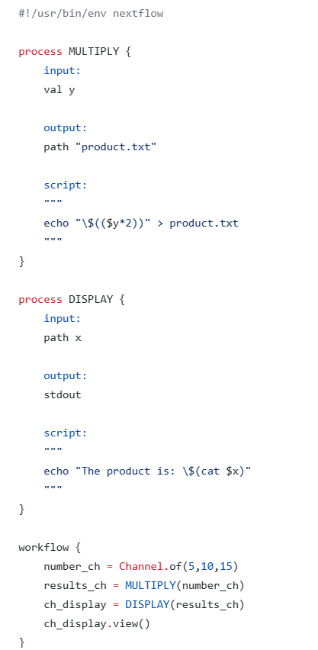
Dataflow paradigm
Example 1:
1. In this code, the workflow starts by defining a Channel called number_ch that contains three integer values: 5, 10, and 15.
2. The first process, MULTIPLY, takes each value from number_ch as input and multiplies it by 2. The output of this process is a file called product.txt that contains the result of the multiplication.
3. The second process, DISPLAY, takes the product.txt file as input and displays its contents on the standard output, along with a text message indicating that it is the product of the original number.
4. In the workflow, the number_ch channel is passed as input to the MULTIPLY process, and the resulting product.txt files are passed as input to the DISPLAY process. The output of the DISPLAY process is displayed on the screen using the view() function.
5. Therefore, the data flows from the number_ch channel to the MULTIPLY process, from the MULTIPLY process to the DISPLAY process, and finally from the DISPLAY process to the screen.

Slide 15
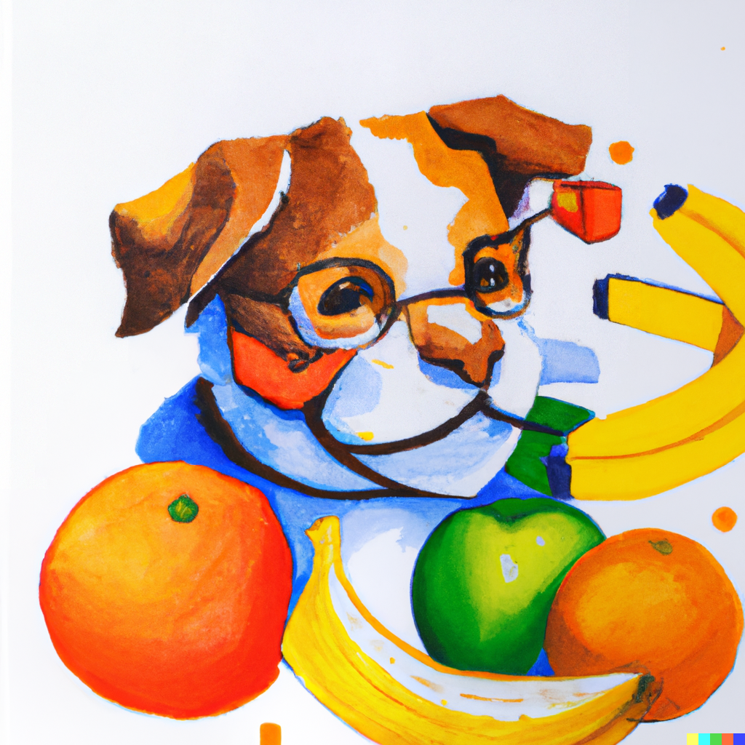
FIFO
In Nextflow, the concept of FIFO (First-In, First-Out) refers to the way that data flows through the pipeline. When a process is executed, it reads input data from its input channels in the order that it was received. The process then produces output data, which is written to its output channels in the same order.
This means that when multiple processes are running in parallel, the order in which they produce output data may not match the order in which they were executed. However, the order of the input data and the output data for each process will always be preserved.
The FIFO concept is important in Nextflow because it ensures that data is processed in a predictable and reproducible way
Example 2

Slide 16
THANK YOU

